Slide 1

Early Years Phonics & Reading
Grove Park

Slide 2
What to expect from this session.
Little Wandle.
What early reading looks like.
How we teach early reading.
How you can support your child at home.
Notes:
How phonics is the magic key to both.

Slide 3
Can you read this sentence? The cat sat on the mat a=a How are we successful at teaching children as young as 4 to read?
Reading
Notes:
!!!!!
How do we do it!

Slide 4
Strategies
1. Securing Phase 1 listening skills
2. A love of reading
3. Early book handling
4. Phase 2 and 3 blends
3. Using picture clues and repeating refrains to aid memory
Many strategies are taught and practiced to help your child learn to read in school.
Notes:
So lets go into those in a bit more detail…

Slide 5
Securing Phase 1 listening skills
Before children learn symbols there must have an understanding how sounds go together to create words.
Learning to listen and recognise the sounds of the world. i.e. car sounds or birds singing.
Learning to listen to the sounds words make, as with rhyme and alliteration.
Alliteration: Dangerous Dylan Oral blending…. Can you find the p..e…n
Make sure you collect a list of our Phase 1 Games to play out and about with your little one.

Slide 6
Phase 2
When your child is secure in Phase 1 and able to hear sounds in words and blend orally, they are ready to learn the letters (shapes of letters on a page).
We learn a few sounds per week - s a t p i n d o c k ck e u r h b f ff l ll s ss
  We learn to recognise the letters name and sound.
  We learn to blend (read) the sounds together – as at sat tap
  We learn to segment the sound i.e. tap – “I can hear t –a –p” – with games
  We do not write in phonics yet
  Phase 3 & 4
  When we are securely blending and segmenting phase 2 sounds we move onto Phase 3 & 4.
  J v w x y z zz sh ch th ng ai ee igh oa oo oo ar oi

Slide 7
Phase 3 & 4
  When we are securely blending and segmenting phase 2 sounds we move onto Phases 3 & 4.
  J v w x y z zz sh ch th ng ai ee igh oa oo oo ar oi
  By this time in the year pupils will have been taught how to form cursive letters and will be applying their segmenting to their writing.

Slide 8
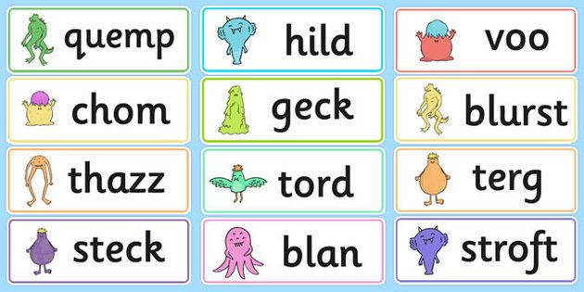
Alien words vs Real words
Alien words are ‘made-up’ words which are used to practise segmenting and blending skills, and specifically phonic reading skills without the other strategies being used. When your little one is ready we will practise these in readiness for the year 1 Phonics screening.
Notes:
As we move through the year – we will begin to get your child used to Alien words!

Slide 9
Early book handling
Learning to hold a book up the right way up.
Learning to turn the pages carefully.
Learning to find the features of the book i.e. front cover, back cover, spine.
Learning to tell the difference between text writing and the pictures.
Phonics blends should only include letters your child has been taught. These will be shared with you on Tapestry each week.

Slide 10
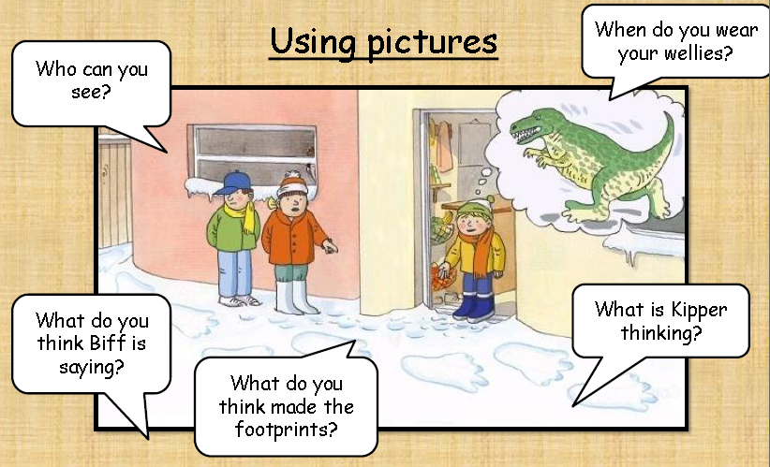
Notes:
Asking questions about the pictures…

Slide 11
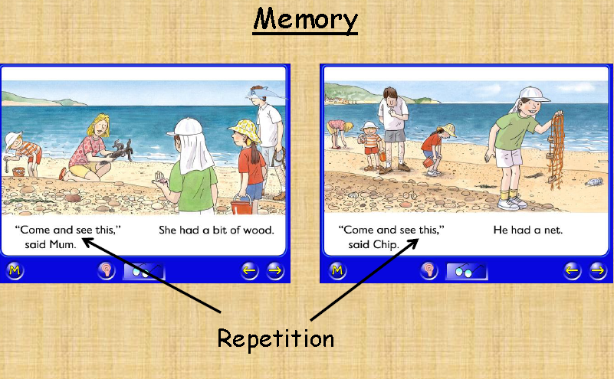
Notes:
Lots of the early word books repeat words – so your child starts to remember them.

Slide 12
Glossary of Phonics terms
Phoneme – 1 sound (s)
Digraph – 2 letters 1 sound (sh)
Trigraph – 3 letters 1 sound (igh)
Notes:
As we learn each of these we learn to blend using them -

Slide 13
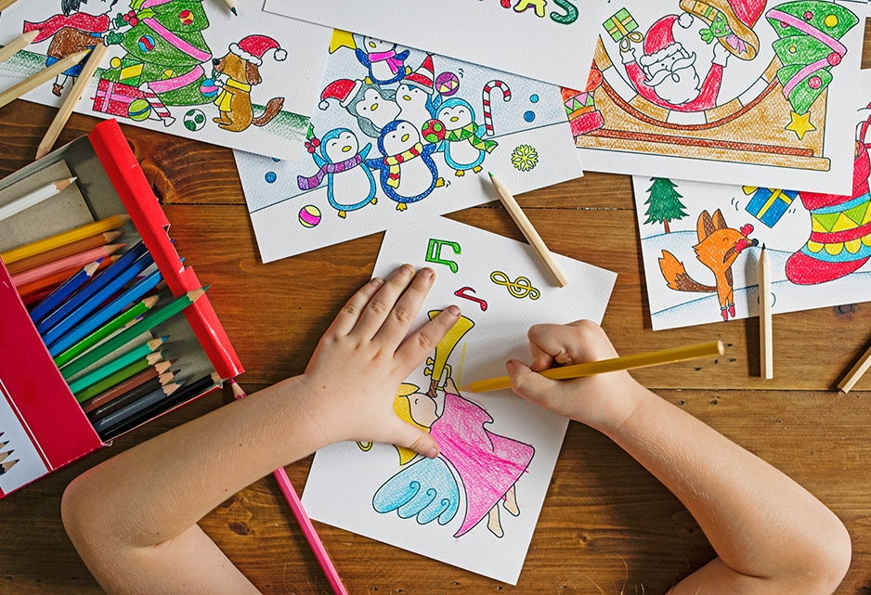

What you can do at home to help?
Practise phonics blends weekly.
Be patient and kind
Play Phase 1 games
Notice initial sounds in what you say d.d.d..dinner
Display your comic strip and refer to it regularly for quick practises
Sing nursery rhymes
Enjoy books together every night.
Tell each other made up stories.
Spot and enjoy text, logos and signs around you.

Slide 14

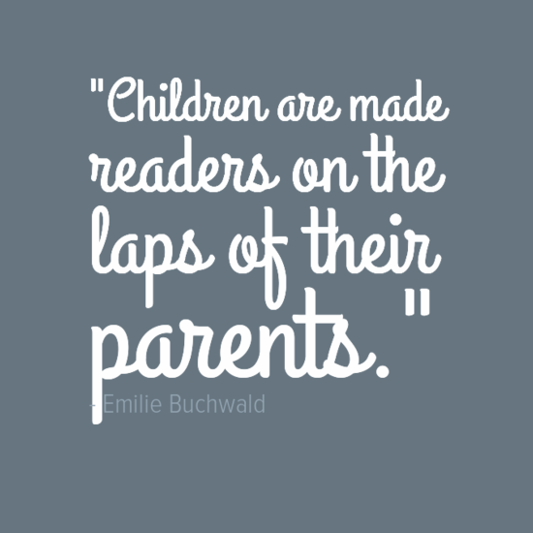



But most importantly….
Discover your own love of reading and your child will copy.

Slide 15
What to do if your child becomes distressed
Come back to it at another time.
Read a page each.
Read to them but deliberately get it wrong!
Read to a younger sibling, pet or even a favourite toy!
Film your child reading.
Read ebooks on the computer or a tablet.
Use your child’s favourite TV to bring phonics to life! Can you BBBing Bunny! That’s alliteration!

Slide 16
Useful Websites
Resources
www.phonicsplay.com
www.letters-and-sounds.com/phase-2.html

Slide 17
Thank you
Remember we are always here to help you.
Please come and find us if you have any questions.
Enjoy these precious new experiences with your child.
Please complete our feedback form attached.

