Slide 1
Learning Through Play
Developmental milestones and EY fundamentals
Complying in short bursts
Structuring free time
High-quality interactions
The importance of outdoor play
Real resourcing

Slide 2

What did you do at school today?
Nothing, just played all day.

Slide 3
What did you do at school today?
Well Mum, I used social relationships to practise my speech and understanding of language whilst learning how to regulate my emotional reactions. I practised my reading, writing and maths though interesting new environments, subconsciously mastering skills that will enable me to tackle a wide range of problems in my future education.
How was your day?

Slide 4
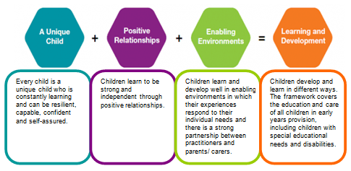
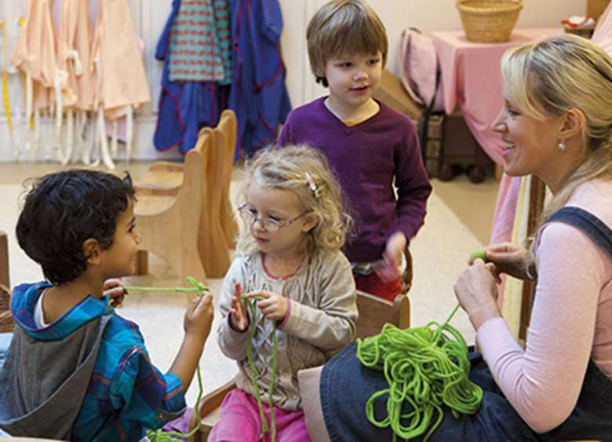

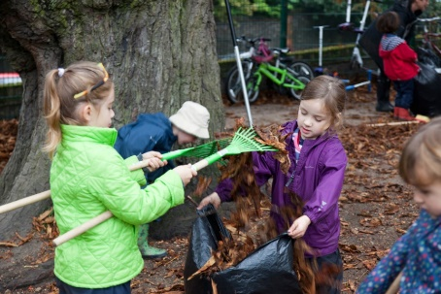
Birth to 5 Matters

Slide 5
Complying in short bursts…
Children as young as 4 should only be asked to sit for a short period of time.
Fine motor activities (child initiated)
Phonics (adult directed)
Plan-Do-Review (child initiated)
Snack (adult directed)
Maths (adult directed)
Lunch time (child initiated)
Topic Time (adult directed)
Plan-Do-Review (child initiated)
Handwriting (adult directed)
Story Time (adult directed)
Home time

Slide 6
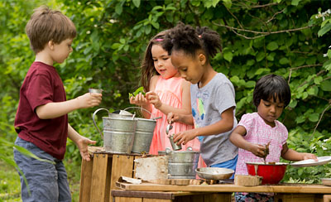
The Choosing time
Plan- Do- Review
Plan – we talk through our plans with friends.
Do – we organise ourselves, find a space and gather what we need independently and work on our plan
Review – we talk about how well the plan went? Give ourselves next steps for the future.
Teaching mindfulness & metacognition everyday
“Learning how to learn” “Thinking about thinking” “knowing about knowing”
If we can teach these skills, alongside a love of learning, we know we are setting pupils up for a life time of learning throughout school and into adult life.

Slide 7
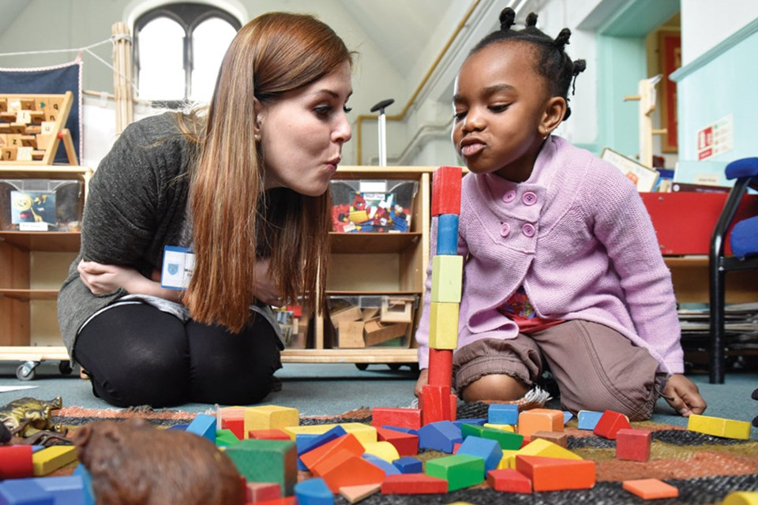
High quality interactions
Casually leave extending resources near by i.e. string, ruler, stickers, or a picture of a wolf.
1. Observe (watch) closely & consider what you know about the child before you interact.
Start to play near by modelling key language. “I’ll huff and I’ll puff and I’ll blow this house down.”
2. Decide how to build on learning.
Craft opportunity for open questioning…
Can you tell me about your blocks?

Slide 8
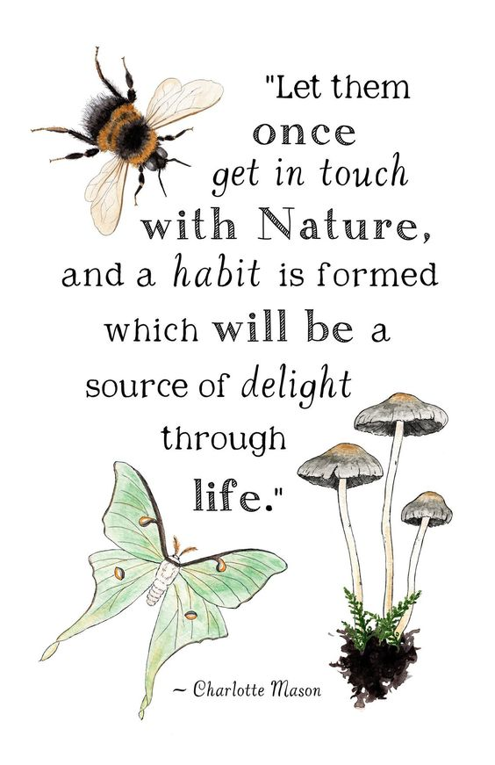
Outdoor Play
In plan-do-review time your child has the choice to work outdoors or in.
Children develop a respect and love of the natural world. If they can do this, they will be able to find joy throughout their lives at no cost.
We run Wildlife Wanderers where activities run outdoors, whatever the weather.
Your child is taught how to harvest moss, what roots do, how to find natural art materials much much more.

Slide 9
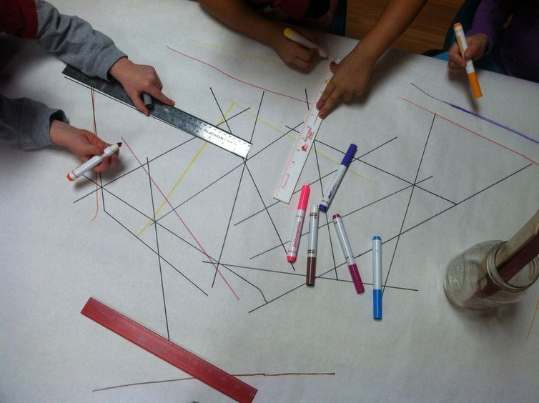
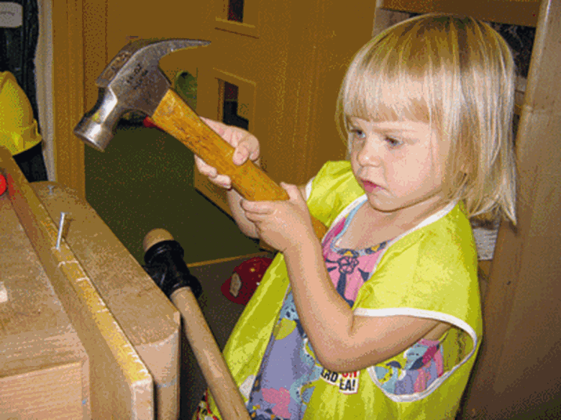
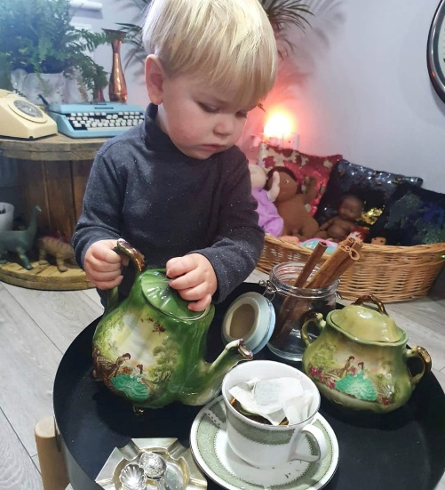
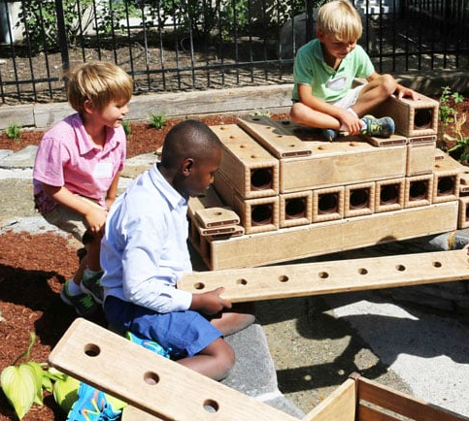
Real resourcing
Real equipment
Real risk
Real responsibility
Really ready for life!

Slide 10
How can I support my child with learning through play at home?
Allow plenty of time for free play.
Encourage children to explain their reasoning. Praise exploration, curiosity and questioning as even messy play is an expression of learning.
Get outside safely – the natural world is full of free resources.
Encourage play with other children… they do all the work for you!

Slide 11



